Slide 1
Access Layer: Object Storage and Object Interoperability
A database management system(Dbms) is a set of programs that enables the creation and maintenance of a collection of related data.
The fundamental purpose of a DBMS to provide
A reliable data storage facility
Efficient convenient data access and retrieval.
Manipulate, protect and manage the data.

Slide 2
Persistence
Persistence refers to the ability of some objects to outlive the programs that created them.
Object Store and Persistence:
An Overview
A program will create a large amount of data throughout its execution. Each item of data will have a different lifetime.
Six broad categories for the lifetime of data

Slide 3
Object Store and Persistence: An Overview
1.Transient results to the evaluation of expressions.
2.Variables involved in procedure activation
3.Global variables and variable that are dynamically allocated .
4. Data that exist between the executions of a program
5. Data that exist between the versions of a program.
6. Data that outlive a program
The first 3 categories are transient the other 3 are non transient or persistent.

Slide 4
Database Management system
A fundamental characteristic of the database approach is that the DBMS contains not only the data but a complete definition of the data formats it manages.
This description is known as the schema or metadata and contains a complete definition of the data formats, such as the data structures ,types and constraints.

Slide 5
Database Views
A database view is a searchable object in a database that is defined by a query.
A view can combine data from two or more table, using joins, and also just contain a subset of information.

Slide 6
Database Models
A database model is a collection of logical constructs used to represent the data structure and data relationships within the database.
Hierarchical Model:
The hierarchical model represents data as a single rooted tree.
A parent child relationship.
A hierarchical model resembles super sub relationships of objects.

Slide 7
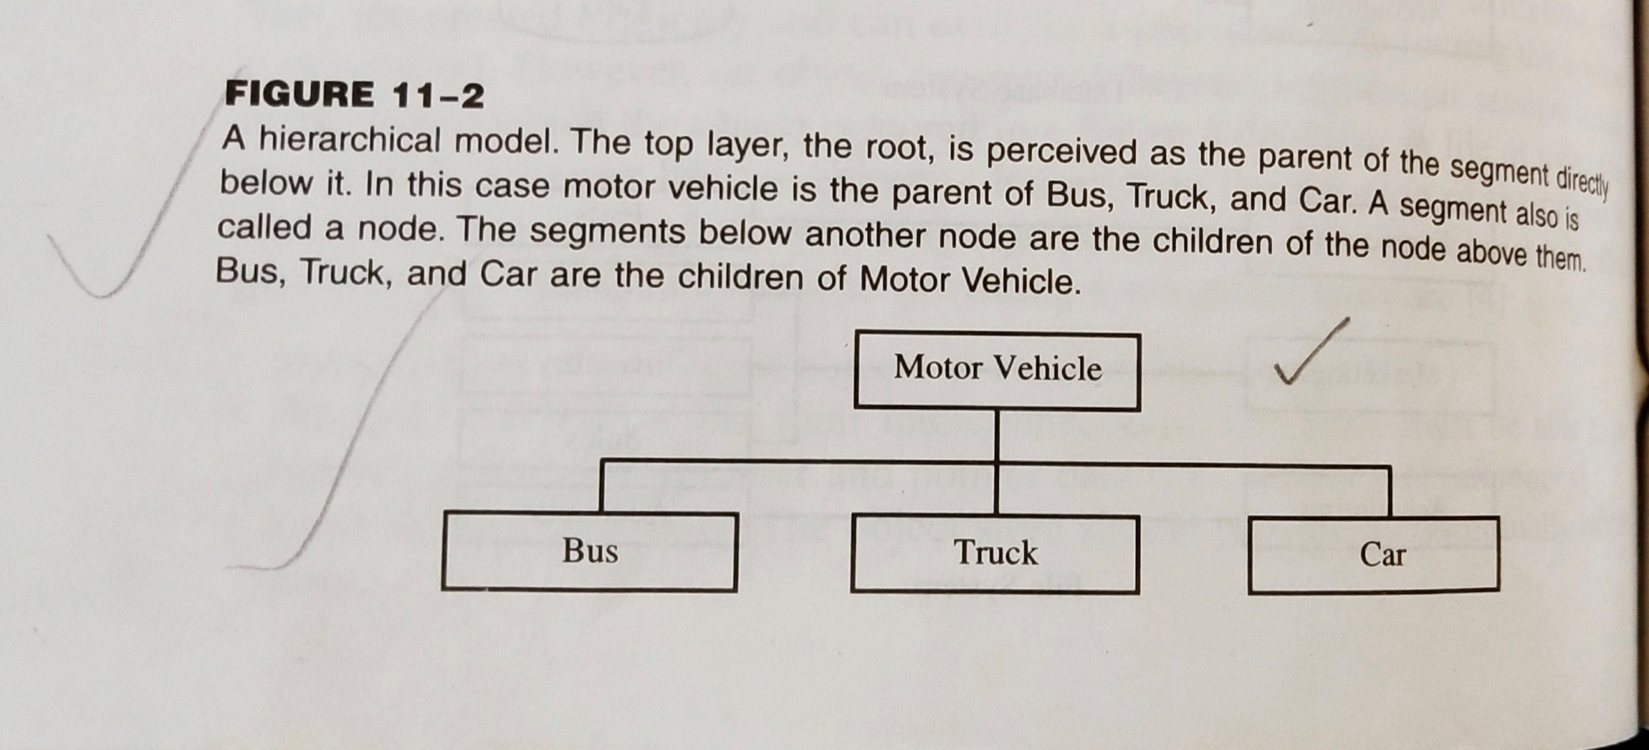
Hierarchical Model

Slide 8
Network Model
A Network database model is similar to a hierarchical database,with one distinction. Unlike hierarchical a network model’s record can have more than one parent.

Slide 9
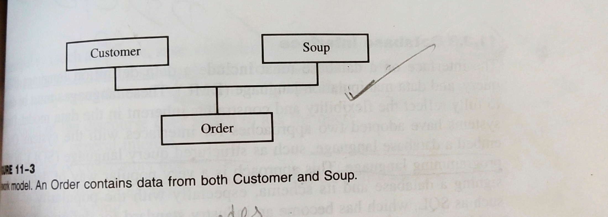
Network Model

Slide 10
Relational model
Of all the database models , the relational model has the simplest, most uniform structure and is the most commercially widespread.
The columns of each table are attributes that define the data or value domain for entries in that column.
The rows of each table are tuple.
A relational table should have only one primary key.

Slide 11
Primary key is a combination of one or more attributes whose value locates each row in a table.
A foreign key is a primary key of one table that is embedded in another table to link the tables.

Slide 12
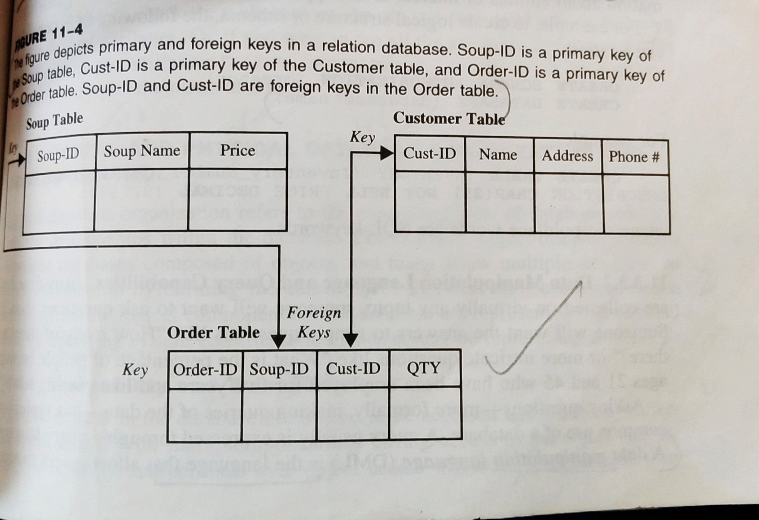
Relational Model

Slide 13
DATABASE INTERFACE
The interface on a database must include a data definition language(DDL) a query and data manipulation language (DML).
SQL | DDL, DML, DCL and TCL Commands
Structured Query Language(SQL) as we all know is the database language by the use of which we can perform certain operations on the existing database and also we can use this language to create a database.
SQL uses certain commands like Create, Drop, Insert etc. to carry out the required tasks.

Slide 14
These SQL commands are mainly categorized into four categories as discussed below:
DDL(Data Definition Language) : DDL or Data Definition Language actually consists of the SQL commands that can be used to define the database schema.
It simply deals with descriptions of the database schema and is used to create and modify the structure of database objects in database.

Slide 15
Examples of DDL commands:
CREATE – is used to create the database or its objects (like table, index,etc)
DROP – is used to delete objects from the database.
ALTER-is used to alter the structure of the database.
TRUNCATE–is used to remove all records from a table, including all spaces allocated for the records are removed.
COMMENT –is used to add comments to the data dictionary.
RENAME –is used to rename an object existing in the database.

Slide 16
DML(Data Manipulation Language) : The SQL commands that deals with the manipulation of data present in database belong to DML or Data Manipulation Language and this includes most of the SQL statements.
Examples of DML:
SELECT – is used to retrieve data from the a database.
INSERT – is used to insert data into a table.
UPDATE – is used to update existing data within a table.
DELETE – is used to delete records from a database table.

Slide 17
DCL(Data Control Language) : DCL includes commands such as GRANT and REVOKE which mainly deals with the rights, permissions and other controls of the database system.
Examples of DCL commands:
GRANT-gives user’s access privileges to database.
REVOKE-withdraw user’s access privileges given by using the GRANT command

Slide 18
.
TCL(transaction Control Language) : TCL commands deals with the transaction within the database.
Examples of TCL commands:
COMMIT– commits a Transaction.
ROLLBACK– rollbacks a transaction in case of any error occurs.
SAVEPOINT–sets a savepoint within a transaction.

Slide 19
Logical and Physical Database Organization and access control
Logical database organization refers to the conceptual view of database structure and the relationships within the database.
For eg , object oriented systems represent databases composed of objects, and many allow multiple databases to share information by defining the same object.
Physical database organization refers to how the logical components of the database are represented in a physical form by operating system constructs(objects may be represented as files)

Slide 20
Shareability and Transactions
Data and objects in the database often need to be accessed and shared by different applications, the conflicts over object access will arise.
The database must detect and mediate these conflicts and promote the greatest amount of sharing possible without sacrificing the integrity of data. This mediation process is managed through concurrency control

Slide 21
ACID Properties
A transaction is a very small unit of a program and it may contain several lowlevel tasks.
A transaction in a database system must maintain Atomicity, Consistency, Isolation, and Durability − commonly known as ACID properties − in order to ensure accuracy, completeness, and data integrity.

Slide 22
Atomicity − This property states that a transaction must be treated as an atomic unit, that is, either all of its operations are executed or none.
Consistency − The database must remain in a consistent state after any transaction. No transaction should have any adverse effect on the data residing in the

Slide 23
Durability − The database should be durable enough to hold all its latest updates even if the system fails or restarts.
If a transaction updates a chunk of data in a database and commits, then the database will hold the modified data.
If a transaction commits but the system fails before the data could be written on to the disk, then that data will be updated once the system springs back into action.

Slide 24
Isolation − In a database system where more than one transaction are being executed simultaneously and in parallel, the property of isolation states that all the transactions will be carried out and executed as if it is the only transaction in the system.
No transaction will affect the existence of any other transaction
A transaction is made to Commit simply means to permanently save all the changes which you have made in the current transaction.
It is Aborted means to disrupt the action by killing the current ongoing transaction if all transactions cannot be made successfully.

Slide 25
Concurrency Policy
A concurrency control policy dictates what happens when conflicts arise between transactions that attempt access to the same object and how these conflicts are to be resolved.
Consistent View of Database
Conservative or persistence policy
Read or write locks

